Slide 1




Cloud Native
Artificial Intelligence
Presentation by Muhammad Talha
Roll number PIAIC179579

Slide 2
Content of the Presentation
Overview
What is Generative AI?
Key Components and CN Tools
Use Cases
Best Practices
Cloud native AI solutions span healthcare, finance, retail, and manufacturing industries, offering diagnostic assistance, fraud detection, personalized recommendations, and predictive maintenance.
Successful implementation of cloud native AI solutions entails aligning objectives with business goals, prioritizing data governance and security, fostering collaboration, and embracing automation and DevOps practices.
Cloud-native AI combines AI with cloud infrastructure for faster development and deployment of applications, driving innovation and competitiveness.
Generative AI synthesizes new data based on learned patterns, fostering creativity and originality across various domains.
Cloud-native AI solutions rely on tools like Kubernetes, Docker, Prometheus, Grafana, and managed services from cloud providers for efficient deployment, scaling, management, and monitoring of AI applications.
What is Cloud Native AI?
Examples of Generative AI
Challenges and Considerations
Future Trends
Cloud Native Artificial Intelligence streamlines AI workload deployment, scaling, and performance optimization on cloud infrastructure, addressing challenges and enhancing efficiency.
Benefits
Future trends in CNAI include AI-Edge-IoT convergence for real-time processing, responsible AI practices emphasizing transparency, and federated learning for collaborative, privacy-preserving model training.
OpenAI's GPT models exemplify Generative AI, capable of generating contextually relevant text across various applications, from content generation to language translation.
Cloud native AI solutions provide scalability, agility, and cost-effectiveness by seamlessly scaling AI workloads, enabling rapid development, and reducing infrastructure costs.
Implementing CNAI solutions requires addressing challenges including data privacy, cost management, skills gap, and interoperability for seamless integration and compliance.
Case Studies
Conclusion
Real-world case studies showcase the transformative impact of cloud native AI, such as improved healthcare outcomes through faster diagnosis and treatment planning, and enhanced security in financial services through fraud detection and risk management.
In conclusion, CNAI revolutionizes development and deployment, leveraging cloud scalability for accelerated innovation and competitive advantage, demanding careful planning and collaboration, yet promising transformative opportunities in the digital age.

Slide 3

Overview
Cloud native artificial intelligence (AI) represents the fusion of AI technologies with cloud computing infrastructure and services. It offers a transformative approach to AI development, leveraging the scalability, flexibility, and resources of cloud platforms. By integrating AI capabilities directly into cloud environments, organizations can accelerate the development and deployment of AI applications, driving innovation and competitive advantage.

Slide 4


What is Cloud-Native Artificial Intelligence
Cloud Native Artificial Intelligence (CNAI) allows the construction of practical systems to deploy, run, and scale AI workloads. CNAI solutions address challenges AI application scientists, developers, and deployers face in developing, deploying, running, scaling, and monitoring AI workloads on cloud infrastructure. By leveraging the underlying cloud infrastructure’s computing (e.g., CPUs and GPUs), network, and storage capabilities, as well as providing isolation and controlled sharing mechanisms, it accelerates AI application performance and reduces costs.

Slide 5
What is Generative AI?
Learning Latent Structures
Human-like Creativity
Generative AI delves into data to unearth hidden patterns, allowing it to understand and mimic the underlying structures, be it in text, images, or other forms of data.
By emulating how humans interpret and create, generative AI exhibits creativity and originality, tapping into learned patterns to produce novel outputs that closely resemble human-generated content.
Creative Synthesis
Versatile Applications
Unlike discriminative AI, which deals with categorization, generative AI thrives in scenarios where outcomes are ambiguous or open-ended. It excels in generating new content like stories, music, or art by extrapolating from learned patterns.
This capability finds utility across various domains, from generating personalized content recommendations to aiding in creative processes like storytelling or artistic endeavors, showcasing its potential in enhancing human-computer interactions and creative workflows.

Slide 6
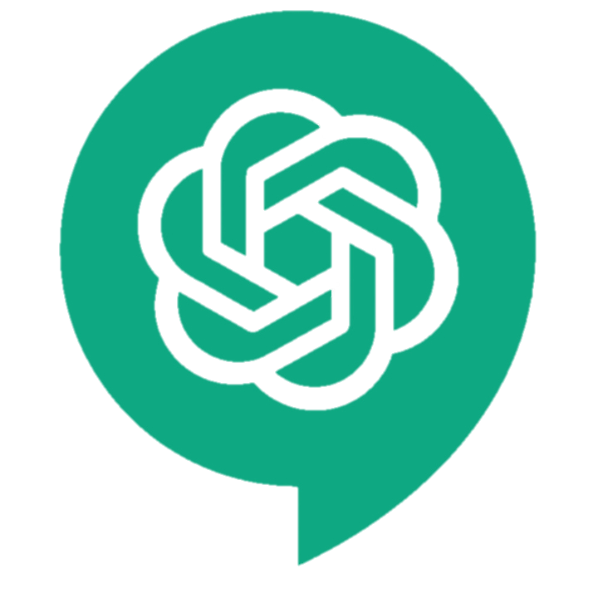
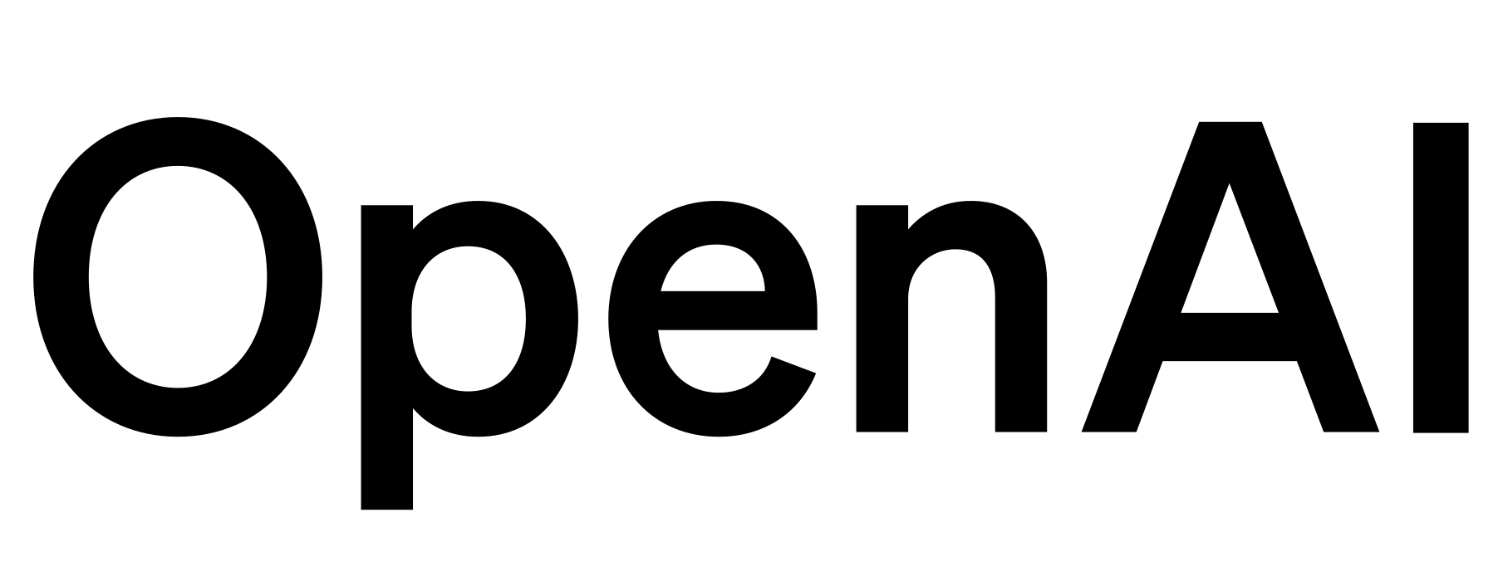
Example of Generative AI
One notable example of Generative AI is OpenAI's GPT (Generative Pre-trained Transformer) models. These models are trained on vast amounts of text data and can generate coherent and contextually relevant text based on a given prompt. For instance, given a sentence or paragraph, a GPT model can continue the text in a plausible manner, mimicking the style and tone of the input. This capability has numerous applications, including content generation, chatbots, language translation, and creative writing assistance.

Slide 7
Key Components and Cloud Native Tools
Building cloud-native AI solutions requires a suite of tools and technologies. Kubernetes, an open-source container orchestration platform, automates the deployment, scaling, and management of containerized applications, providing resilience and portability. Docker is used for containerization, enabling developers to package applications and dependencies into lightweight, portable containers that can run consistently across different environments. Prometheus and Grafana are popular monitoring and observability tools used to collect, visualize, and analyze metrics from cloud-native environments, ensuring optimal performance and reliability. Additionally, cloud providers offer managed services such as AWS SageMaker, Google Cloud AI Platform, and Microsoft Azure Machine Learning, which provide integrated tools for AI model development, training, and deployment on their respective platforms.

Slide 8
Benefits of CNAI
Scalability
Agility
Cloud native AI allows seamless scaling of workloads, ensuring optimal performance.
Rapid development and deployment reduce time-to-market, boosting competitiveness.
Cost Efficiency
Resource Optimization
Leveraging cloud infrastructure minimizes costs in provisioning and maintenance.
Efficient resource allocation maximizes utilization and minimizes waste.
Reduced Maintenance
Enhanced Innovation
Offloading maintenance tasks to providers frees internal resources.
Cost savings and agility foster a culture of experimentation and innovation.

Slide 9
Use Cases of Cloud Native Artificial Intelligence
Cloud native AI solutions have diverse applications across various industries. In healthcare, AI-powered diagnostic systems can analyze medical images, detect anomalies, and assist clinicians in making accurate diagnoses and treatment decisions. In finance, AI algorithms are used for fraud detection, risk assessment, and algorithmic trading, improving security and regulatory compliance. In retail, AI-driven recommendation engines provide personalized product recommendations, enhancing customer engagement and driving sales. In manufacturing, AI-enabled predictive maintenance systems can anticipate equipment failures, optimize maintenance schedules, and minimize downtime, improving operational efficiency and reducing costs.

Slide 10
Challenges and Considerations
Despite the benefits, implementing cloud native AI solutions presents several challenges and considerations. Organizations must address issues such as data privacy and security, ensuring that sensitive data is protected and compliant with regulations such as GDPR and HIPAA. Additionally, managing and optimizing cloud costs can be complex, requiring careful monitoring and governance to avoid unexpected expenses. Organizations also need to consider the skills gap and talent shortage in cloud native and AI technologies, investing in training and upskilling initiatives to build and retain a capable workforce. Furthermore, ensuring interoperability and compatibility between different cloud services and platforms is essential for seamless integration and scalability of cloud native AI solutions.

Slide 11

Best Practices
Clear Objectives Alignment
Define clear AI deployment objectives aligned with business goals and priorities.
Data Governance Focus
Prioritize robust data governance and security measures to safeguard sensitive data.
Cross-functional Collaboration
Foster collaboration between data scientists, developers, and IT teams to ensure alignment throughout the AI lifecycle.
Automation and DevOps Adoption
Embrace automation and DevOps practices for seamless integration, deployment, and monitoring of cloud native AI applications.
Continuous Improvement
Implement processes for ongoing optimization and innovation.

Slide 12

Future Trends
Looking ahead, several emerging trends are shaping the future of cloud native AI. One key trend is the convergence of AI with edge computing and IoT, enabling real-time processing and analysis of data at the network edge, closer to the data source. This trend has implications for applications such as autonomous vehicles, smart cities, and industrial automation, where low latency and high reliability are critical. Another trend is the rise of explainable AI and responsible AI practices, focusing on transparency, accountability, and ethical considerations in AI algorithms and decision-making processes. Federated learning is also gaining traction, enabling collaborative model training across distributed data sources while preserving data privacy and security.

Slide 13

Case Studies
Real-world case studies provide tangible examples of the benefits and outcomes of cloud native AI implementations. For example, a healthcare organization implemented a cloud native AI solution for medical image analysis, resulting in faster diagnosis and treatment planning for patients, leading to improved outcomes and reduced healthcare costs. Similarly, a financial services firm leveraged cloud native AI for fraud detection and risk management, enhancing security and regulatory compliance while minimizing financial losses due to fraudulent activities. These case studies demonstrate the transformative potential of cloud native AI across diverse industries and use cases.

Slide 14
Conclusion
In conclusion, cloud native artificial intelligence represents a powerful paradigm shift in AI development and deployment, enabling organizations to harness the scalability, agility, and efficiency of cloud computing for AI workloads. By integrating AI capabilities directly into cloud environments, organizations can accelerate innovation, drive competitive advantage, and deliver value to customers and stakeholders. However, successful implementation requires careful planning, collaboration, and adherence to best practices. By embracing cloud native AI solutions, organizations can unlock new opportunities, overcome challenges, and thrive in the digital era.

